Slide 1
Car Rental APPLICATION Project
MAD314 Mobile Application 1 Group Project
Fall 2019
Teacher: Richard Grand’Maison
Submitted By:
Gurpreet kaur
Babita Pal
Amninder kaur
Sahil Lathar

Slide 2
Introduction….CAR RENTAL
It’s an mobile application designed for a Car Rental Corporation. The application is used by both the customers who desire the rental cars and the employees who must manage the company.
The application is storing the following information:
A list of customers
A list of employees
A list of vehicles
A list of transactions
Rentals
Reservations
Returns

Slide 3
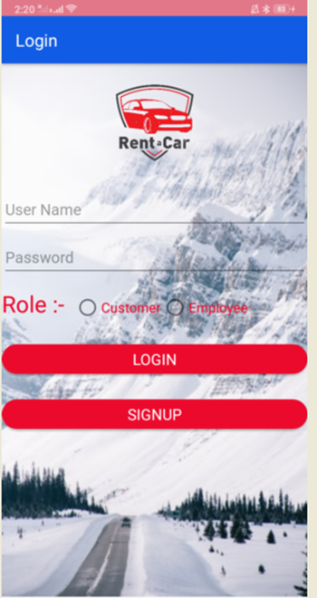
LOGIN PAGE
Login page is the starting point of our project where employee and customer can either login into the car rental application, if already exist or both of them can signup where customer is able to experience the great deals on cars and employee manage the customer list and vehicles.

Slide 4
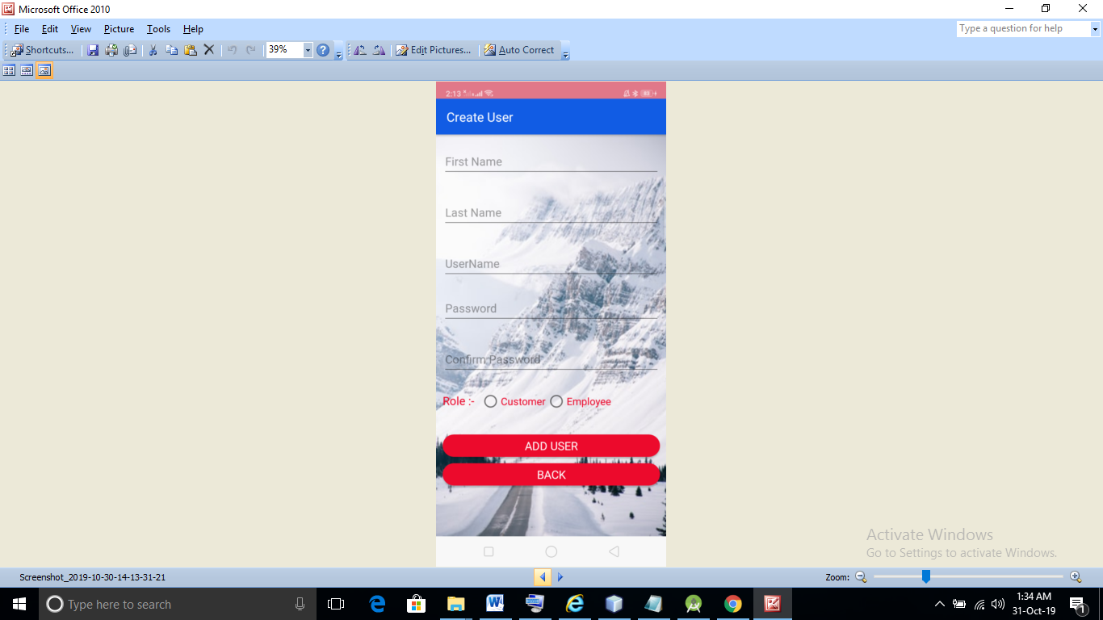
SIGNUP PAGE
The second page is of our project where both user and employee can create there account.
To create the account its mandatory to have name, username and password.
Username must be unique.

Slide 5
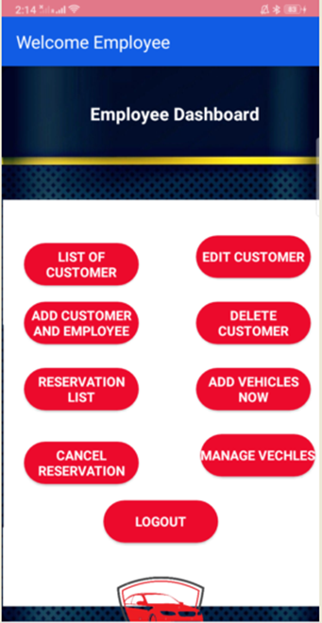
EMPLOYEE DASHBOARD
It’s an employee welcome page. Here, employee can access the following options :
List of customers
Edit customers
Add customer and employee
Delete customer
Reservation list
Add vehicles now
Cancel reservation
Manage vehicles
logout

Slide 6
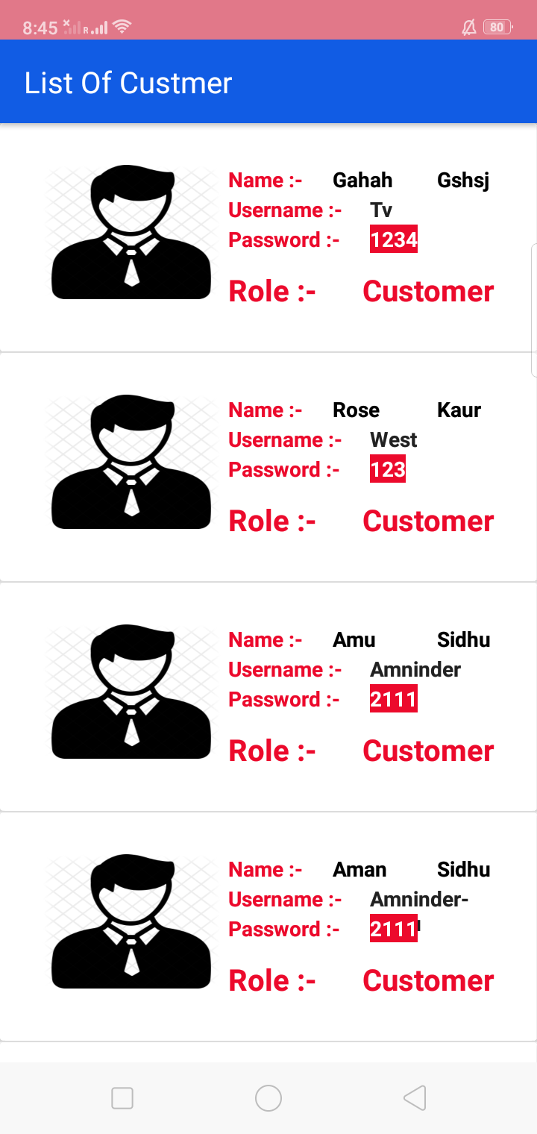
Customer list
Is the list where number of customers, are shown who are using the application.
This list contains the name of the customer, username, password and role of it in a card view.

Slide 7
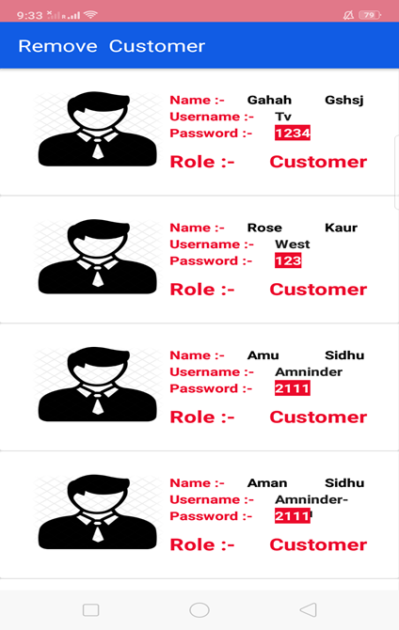
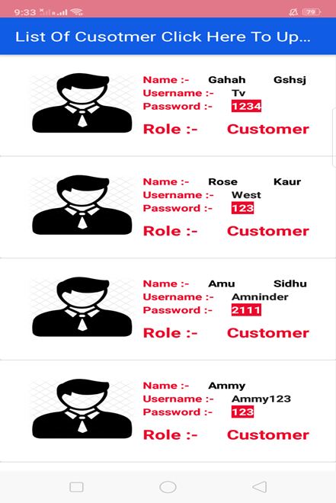
Delete AND EDIT Client
REMOVE
EDIT
Employee can delete and edit the customer data according to his needs.
On clicking the edit option, it will takes the employee to the customer updation page where he can do the updation when required.

Slide 8
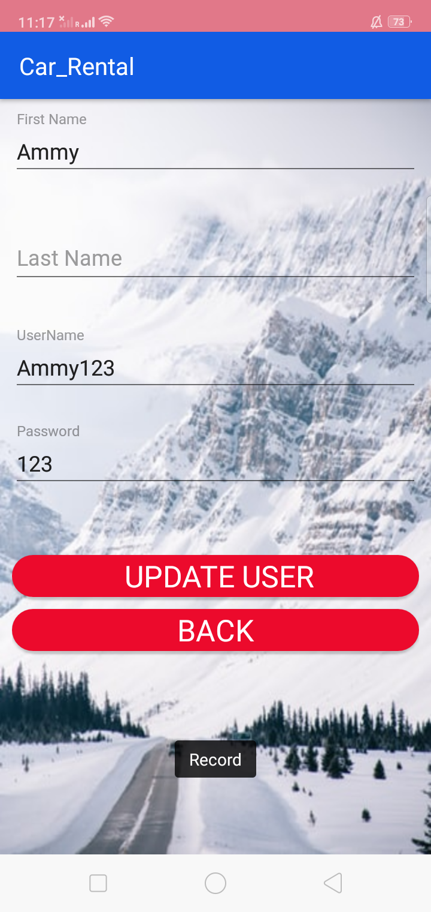
UPDATE CUSTOMER INFORMATION
This page updates the first and last name, username and password of the customer.

Slide 9
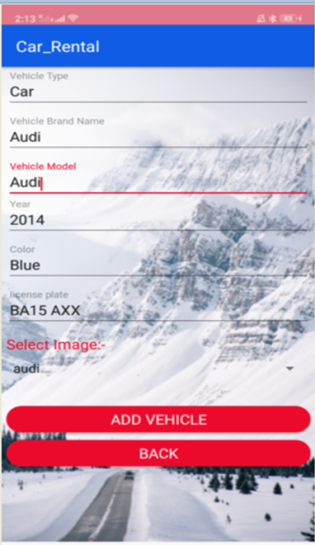
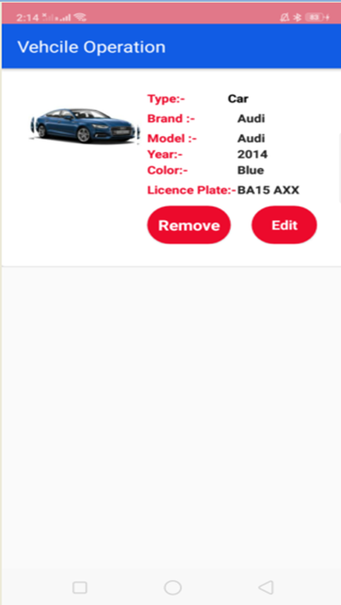
ADD VEHICAL
Add vehicle page gives two option first it will allow the employee to add the information about the new car for rental purpose.
Add vehicle page has:
vehicle type
vehicle brand name
vehicle model
year
colour
licence plate
Car image

Slide 10
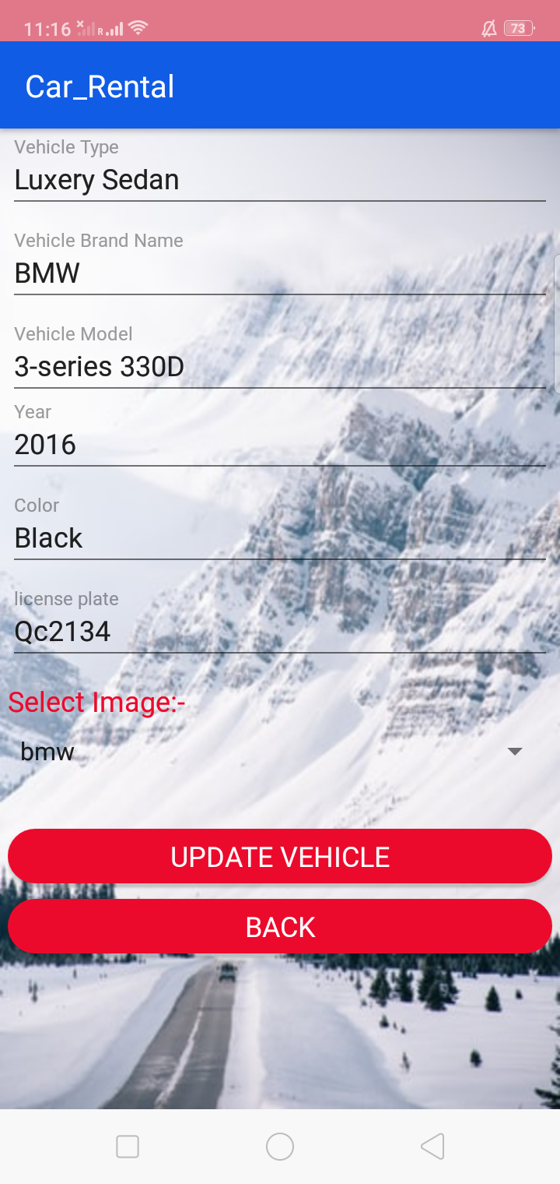
Edit vehicle
When employee wants to change the information regarding any vehicle he has option for doing it by clicking on the edit option under vehicle information.

Slide 11
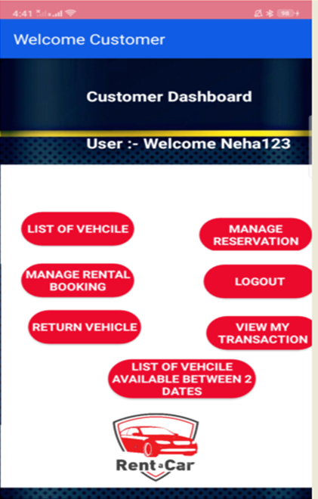
CUSTOMER dASHBOARD
In a customer dashboard, user can view the various options after his the successful login such as:
List of vehicles
Manage reservation
Manage rental booking
Return vehicle
View my transaction
List of vehicles available between two dates
Logout

Slide 12
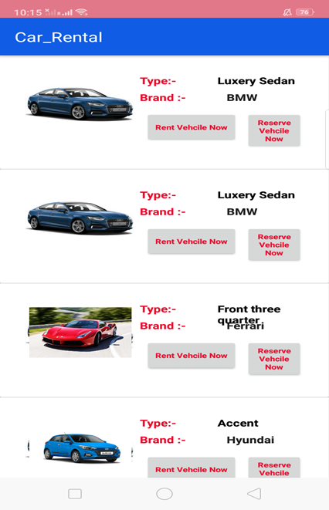
LIST OF VEHICAL
Shows up the different number of cars with its images.
Each car option shows its brand and type.
Customer gets the option of renting or reserving it for the future use.
Recycleview is used to make the list of vehicles.

Slide 13
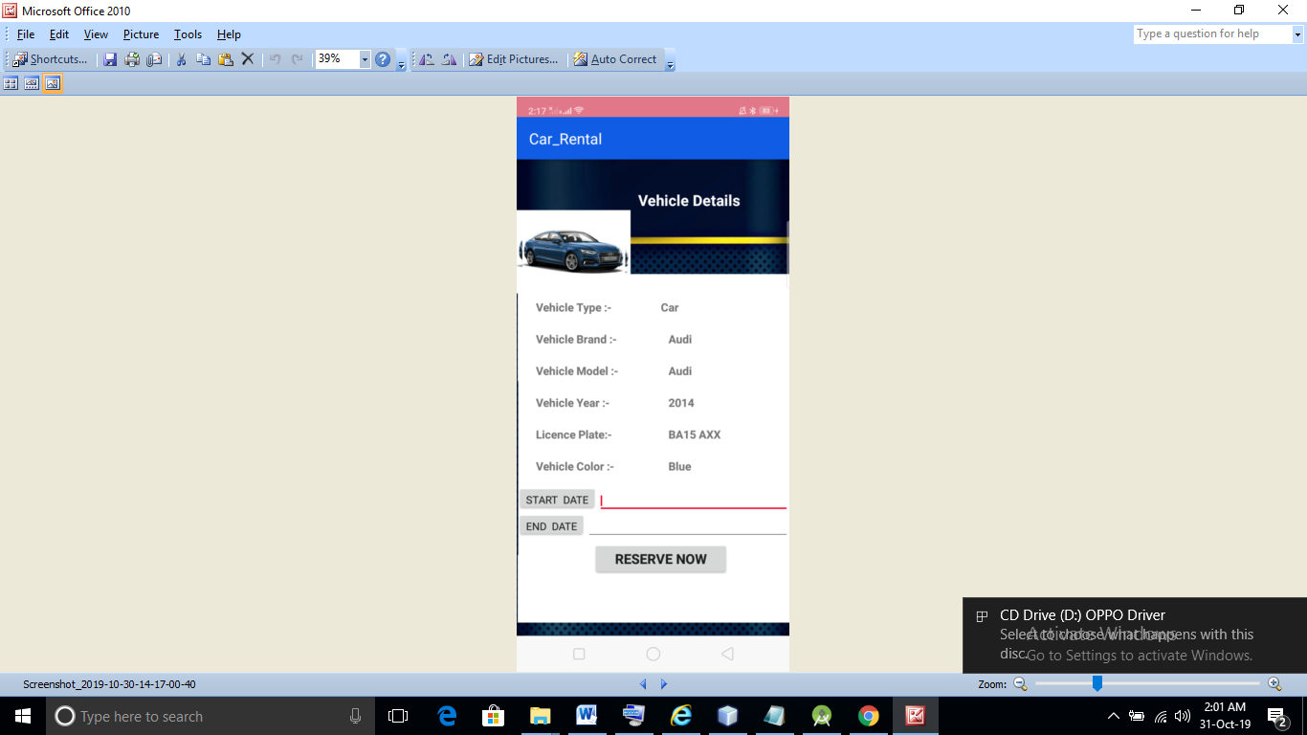
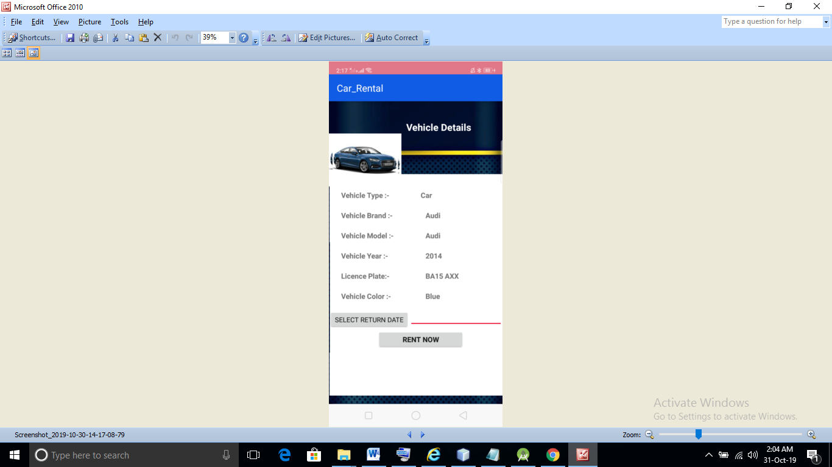
RESERVE VECHICAL & RENT A VEHICAL

Slide 14
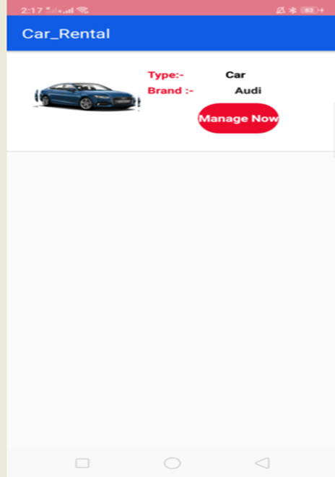
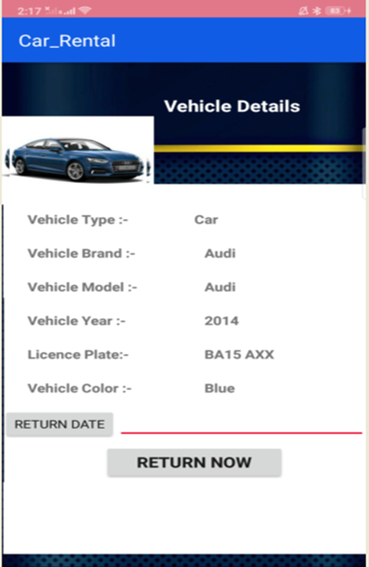
MANAGE RENtaL BOOKING

Slide 15
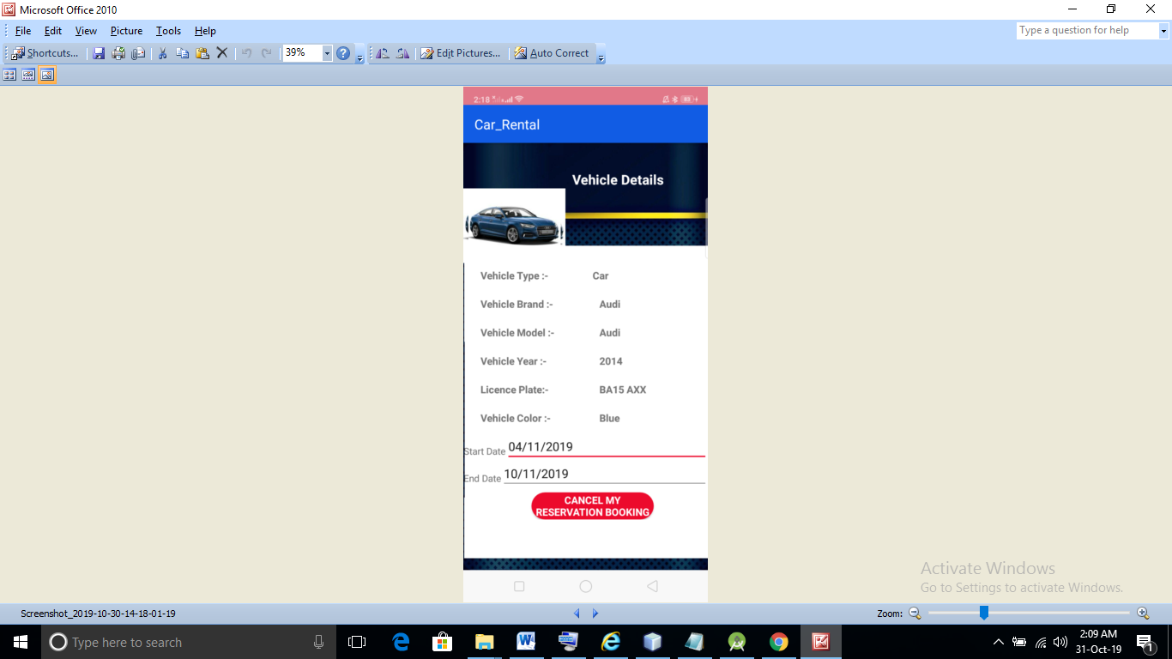
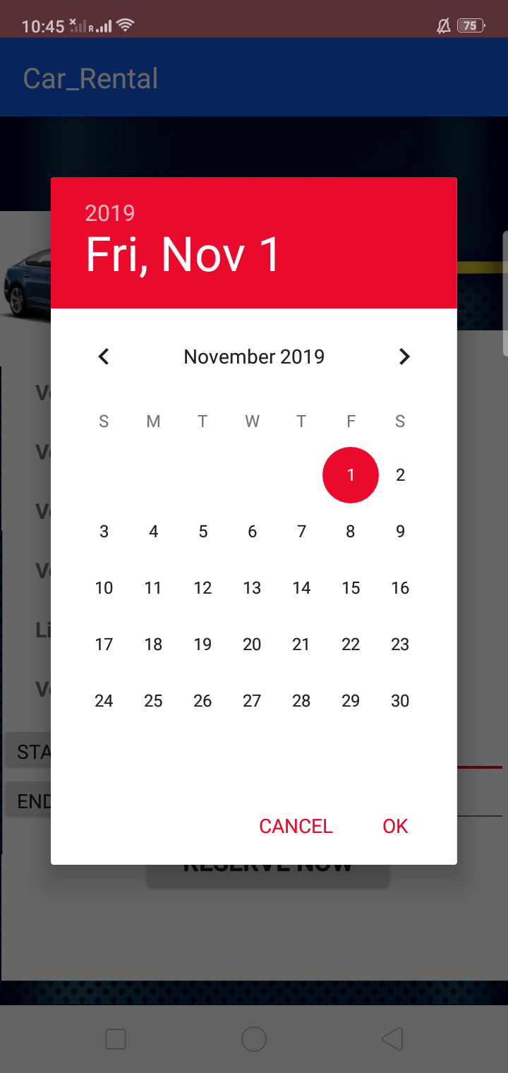
CANCEL RESERVATION

Slide 16
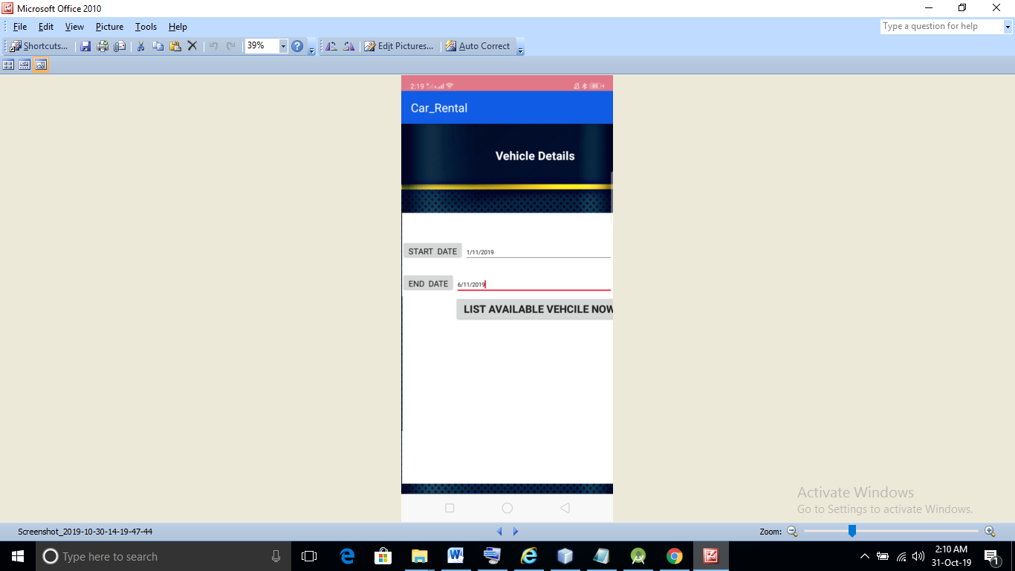

LIST OF AVAILABLE VEHICLES BETWEEN TWO DAYS

Slide 17
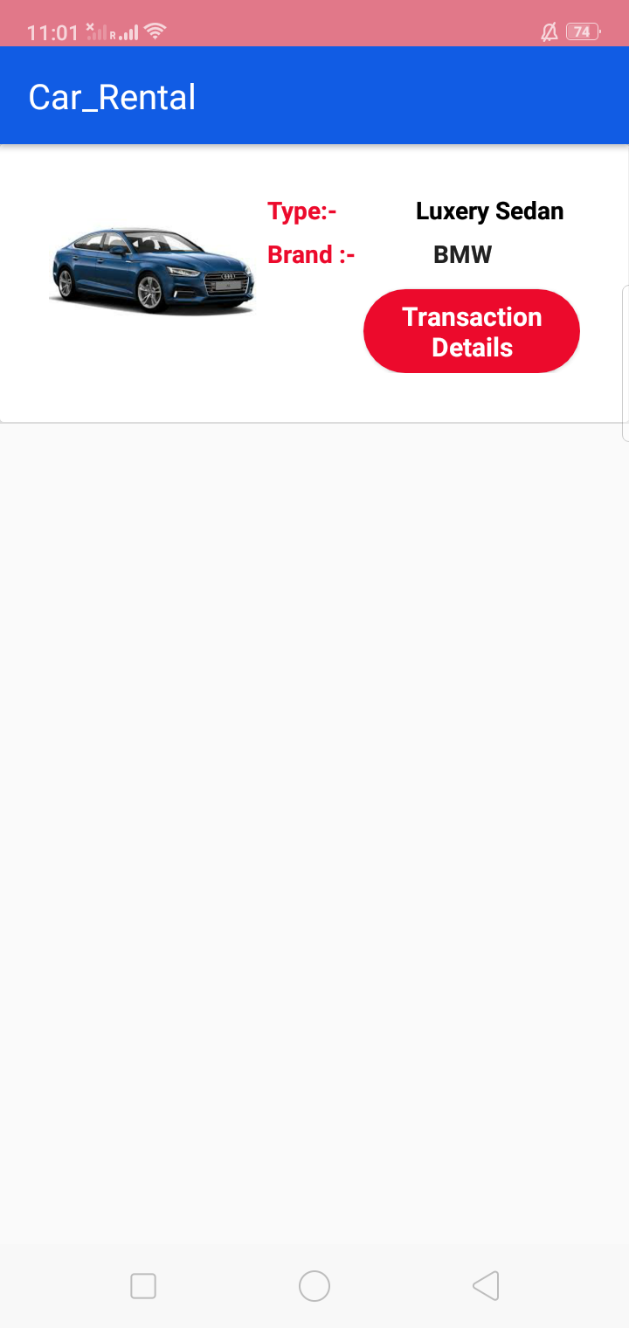
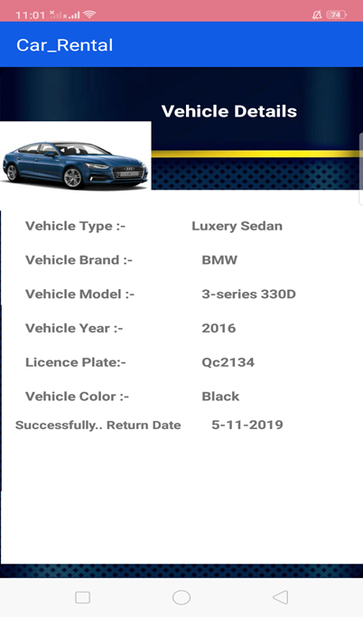
VIEW OF MY TRANSACTIONS

Slide 18
THANK YOU…

